Slide 1
Unit 1-5
Classifying Angles
PLANE Geometry

Slide 2
Adjacent Angles:
2 Angles that Lie in the Same Plane and Have a Common Vertex and a Common Side, but No Common Interior Points
$$m∠1 and m∠2 are Adjacent Angles$$
1
2
●

Slide 3
Linear Pair:
A Pair of Adjacent Angles with Noncommon Sides that are Opposite Rays
Will Always Form a Straight Angle
$$m∠1 and m∠2 Form a Linear Pair$$
1
2

Slide 4
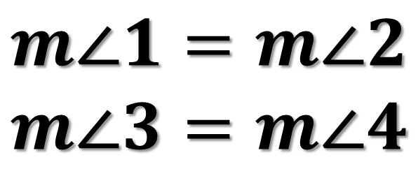
Vertical Angles:
2 Nonadjacent Angles Formed by Two Intersected Lines
$$m∠1 and m∠2 are Vertical Angles$$
$$m∠3 and m∠4 are Vertical Angles$$
3
$$m∠1=m∠2$$
$$m∠3=m∠4$$
1
2
4

Slide 5

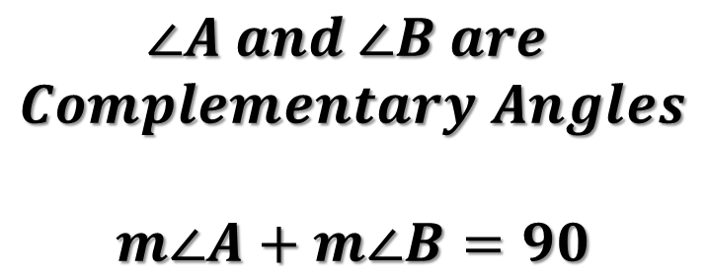

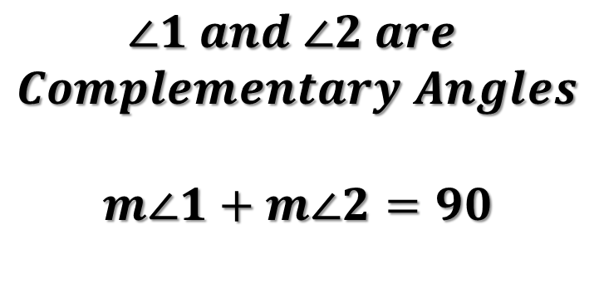


Complementary Angles:
2 Angles with Measures that have a Sum of 90
$$37°$$
$$1$$
$$2$$
A
$$53°$$
B
$$∠1 and ∠2 are$$
$$Complementary Angles$$
$$m∠1+m∠2=90$$
$$∠A and ∠B are$$
$$Complementary Angles$$
$$m∠A+m∠B=90$$

Slide 6





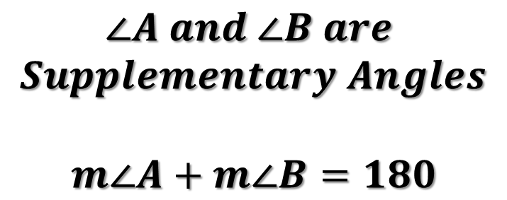
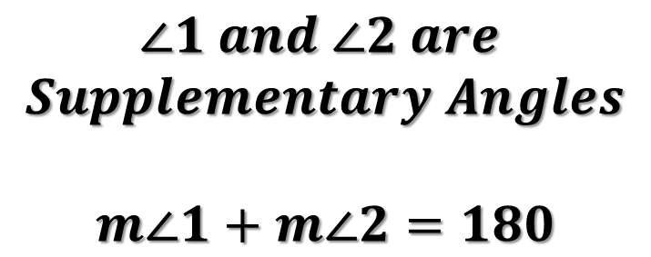

Supplementary Angles:
2 Angles with Measures that have a Sum of 180
$$124°$$
$$56°$$
●
●
$$1$$
$$2$$
$$A$$
$$B$$
●
$$∠1 and ∠2 are$$
$$Supplementary Angles$$
$$m∠1+m∠2=180$$
$$∠A and ∠B are$$
$$Supplementary Angles$$
$$m∠A+m∠B=180$$

Slide 7






Example 1
Identify the Types of Angles
Complementary:
Supplementary:
Vertical:
Adjacent:
$$D$$
$$C$$
$$E$$
$$B$$
$$A$$
$$F$$

Slide 8









Example 2
Find the Missing Angles
$$m∠1=$$
$$m∠2=$$
$$3$$
$$4$$
$$2$$
$$m∠3=$$
$$1$$
$$42°$$
$$m∠4=$$

Slide 9
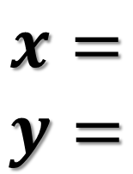
Example 3
Find the measure of the given angle.
4x°
y°
(3x + 35)°
$$x=$$
$$y=$$

Slide 10

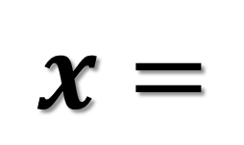

Example 4
Find the measure of the given angle.
$$x=$$
$$50°$$
$$2x$$

Slide 11


Example 5
Find the measure of the given angle.
$$x=$$
$$(2x−6)°$$
$$(3x+31)°$$

Slide 12
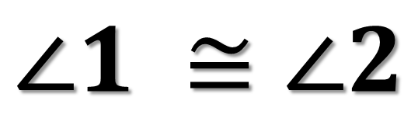

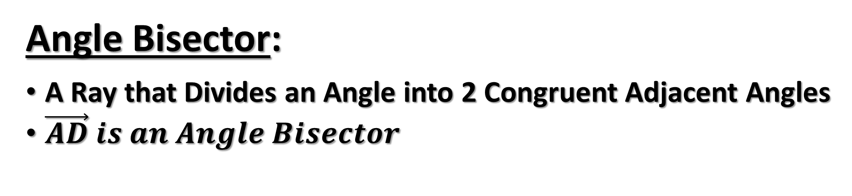



Angle Bisector:
A Ray that Divides an Angle into 2 Congruent Adjacent Angles
$\vec{AD} is an Angle Bisector$
$$∠1 ≅∠2$$
$$B$$
●
$$D$$
●
1
2
●
●
$$A$$
$$C$$

Slide 13


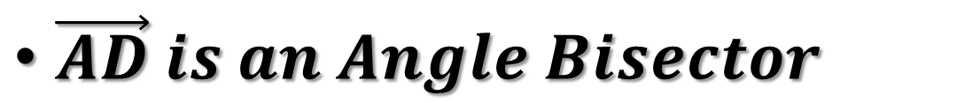








Example 6
$\vec{AD} is an Angle Bisector$
$$x=$$
$$m∠BAD=$$
●
$$B$$
$$m∠DAC=$$
$$m∠BAC=$$
$$D$$
●
$$(6x+6)°$$
$$(x+26)°$$
●
●
$$A$$
$$C$$

